Slide 1


Voting is Public Health: Voting, Civic Engagement, and the Road to the Midterms
Monday, September 28th
1:00 – 2:00 PM ET

Slide 2

MODERATOR
Tim Leshan, MPA
Chief External Relations & Advocacy Officer
ASPPH

Slide 3


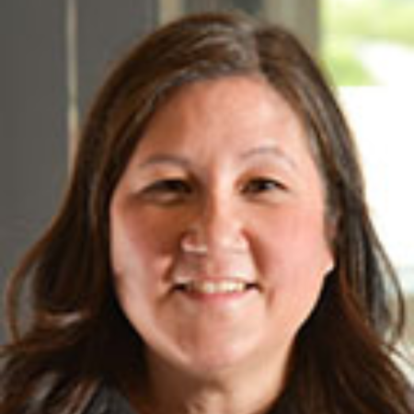
PRESENTERS
Dr. Gnora Mahs, DrPH, MPH
Senior Advisor
Health & Democracy
Beeta Rasouli, MPH
Director of Advocacy &
Federal Affairs
ASPPH
Amy Souders
Principal & Director
Cornerstone Government Affairs

Slide 4

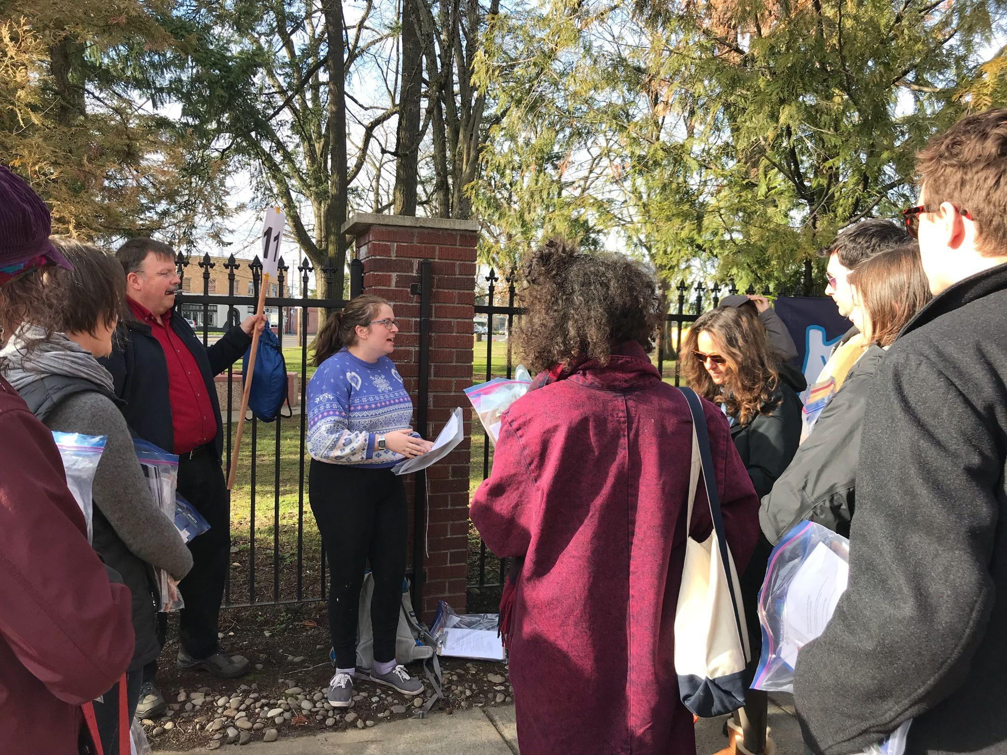

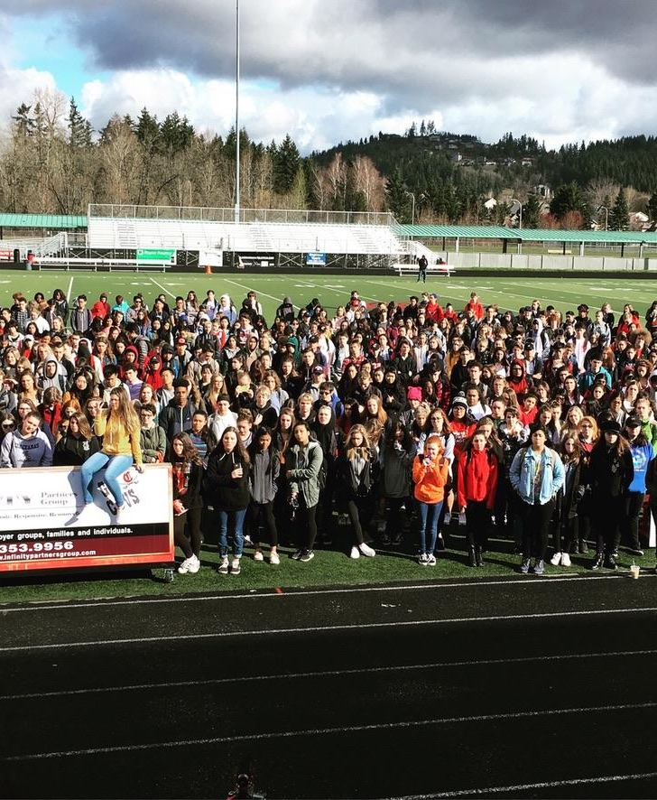

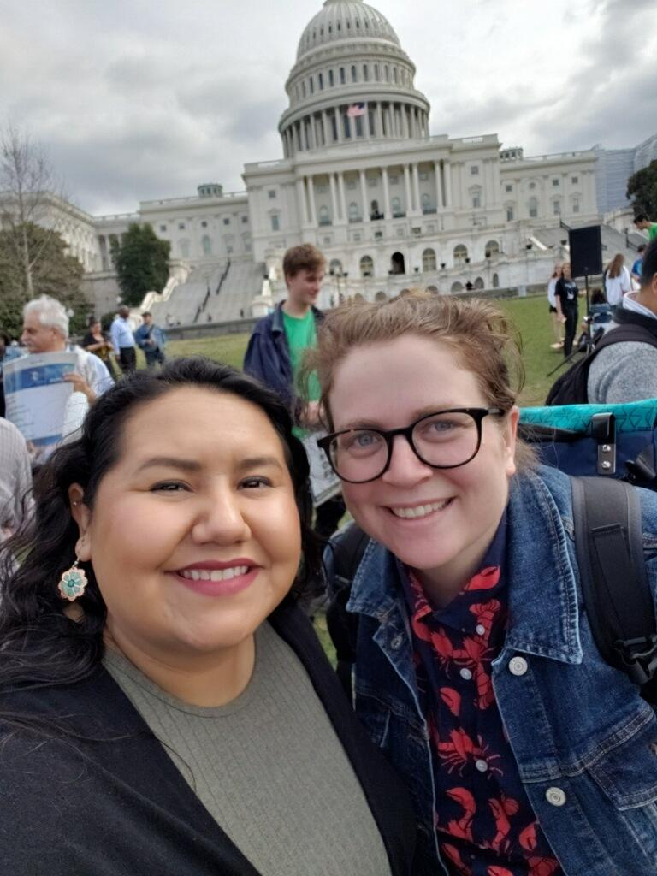

My Story
Health & Democracy
| 4

Slide 5
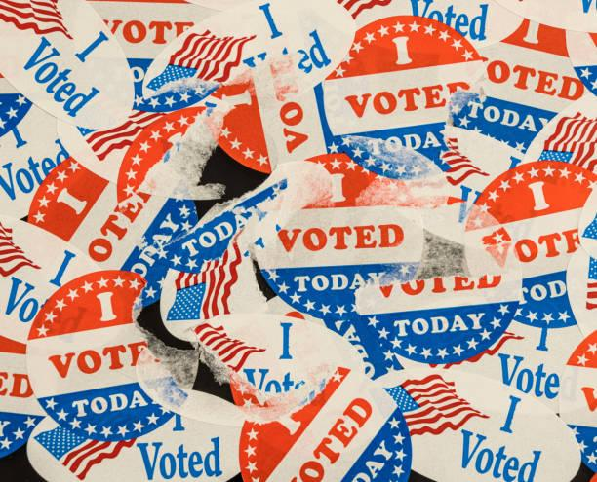

HEALTH IS ALWAYS ON THE BALLOT
Public Safety & Violence prevention
Health care access
Early childhood investments
Climate resiliency
Pandemic & infectious disease prevention
Maternal and Infant Health
Reproductive Health
Public Health Authority
Housing, water, food, education, transportation, civil rights
Health & Democracy
| 5

Slide 6
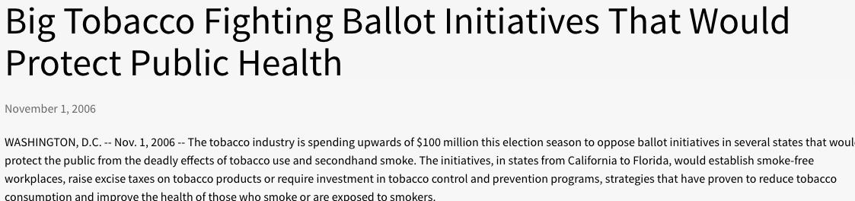
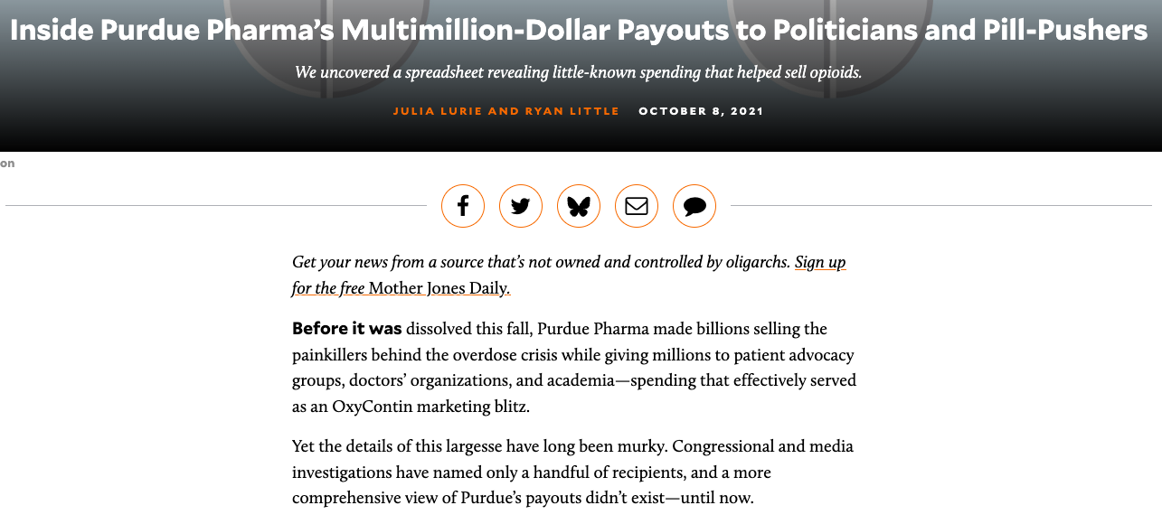
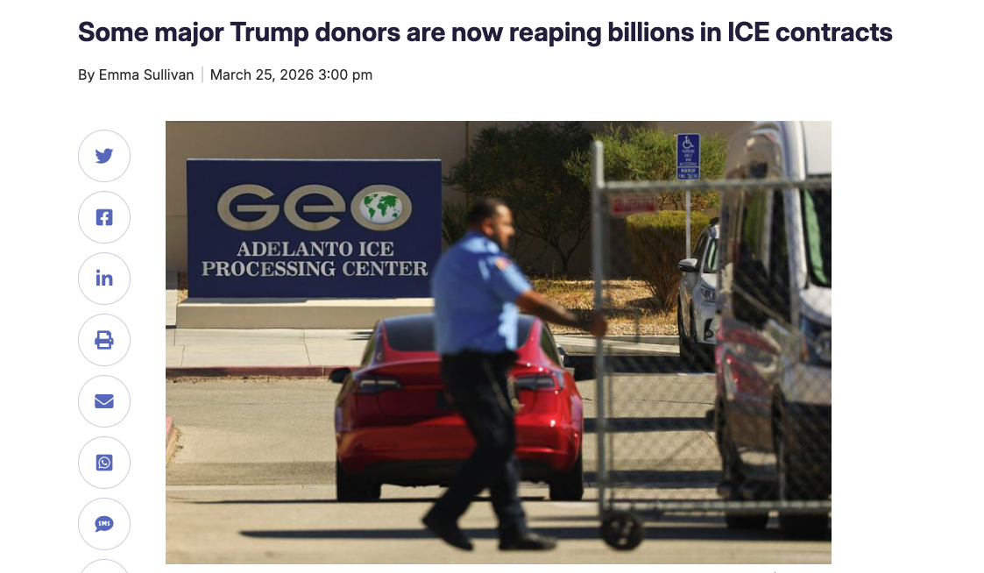
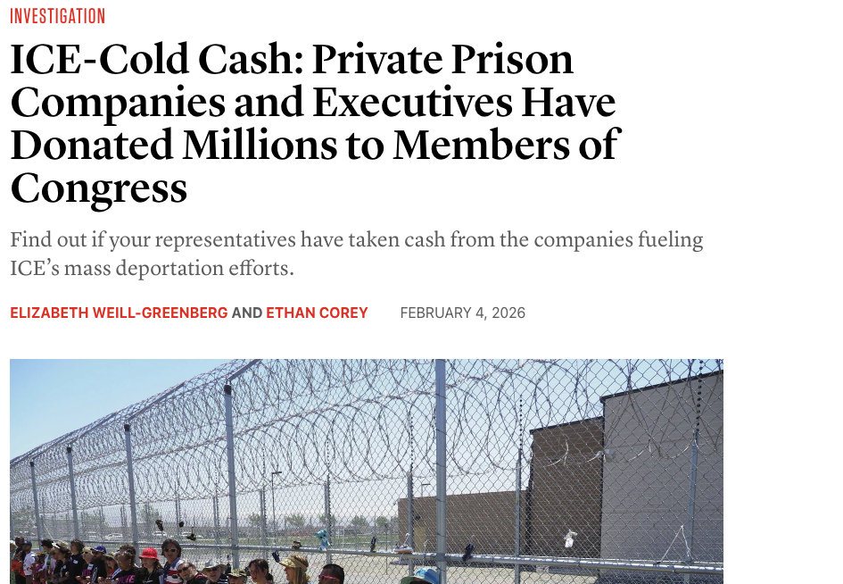
WE MUST BUILD POWER
Health & Democracy
| 6

Slide 7
HEALTH & DEMOCRACY ARE INTERDEPENDENT
Civic and voter participation
Power to influence policy
When Democracy is Healthy, People are Healthy
Health outcomes
Health & Democracy
| 7

Slide 8
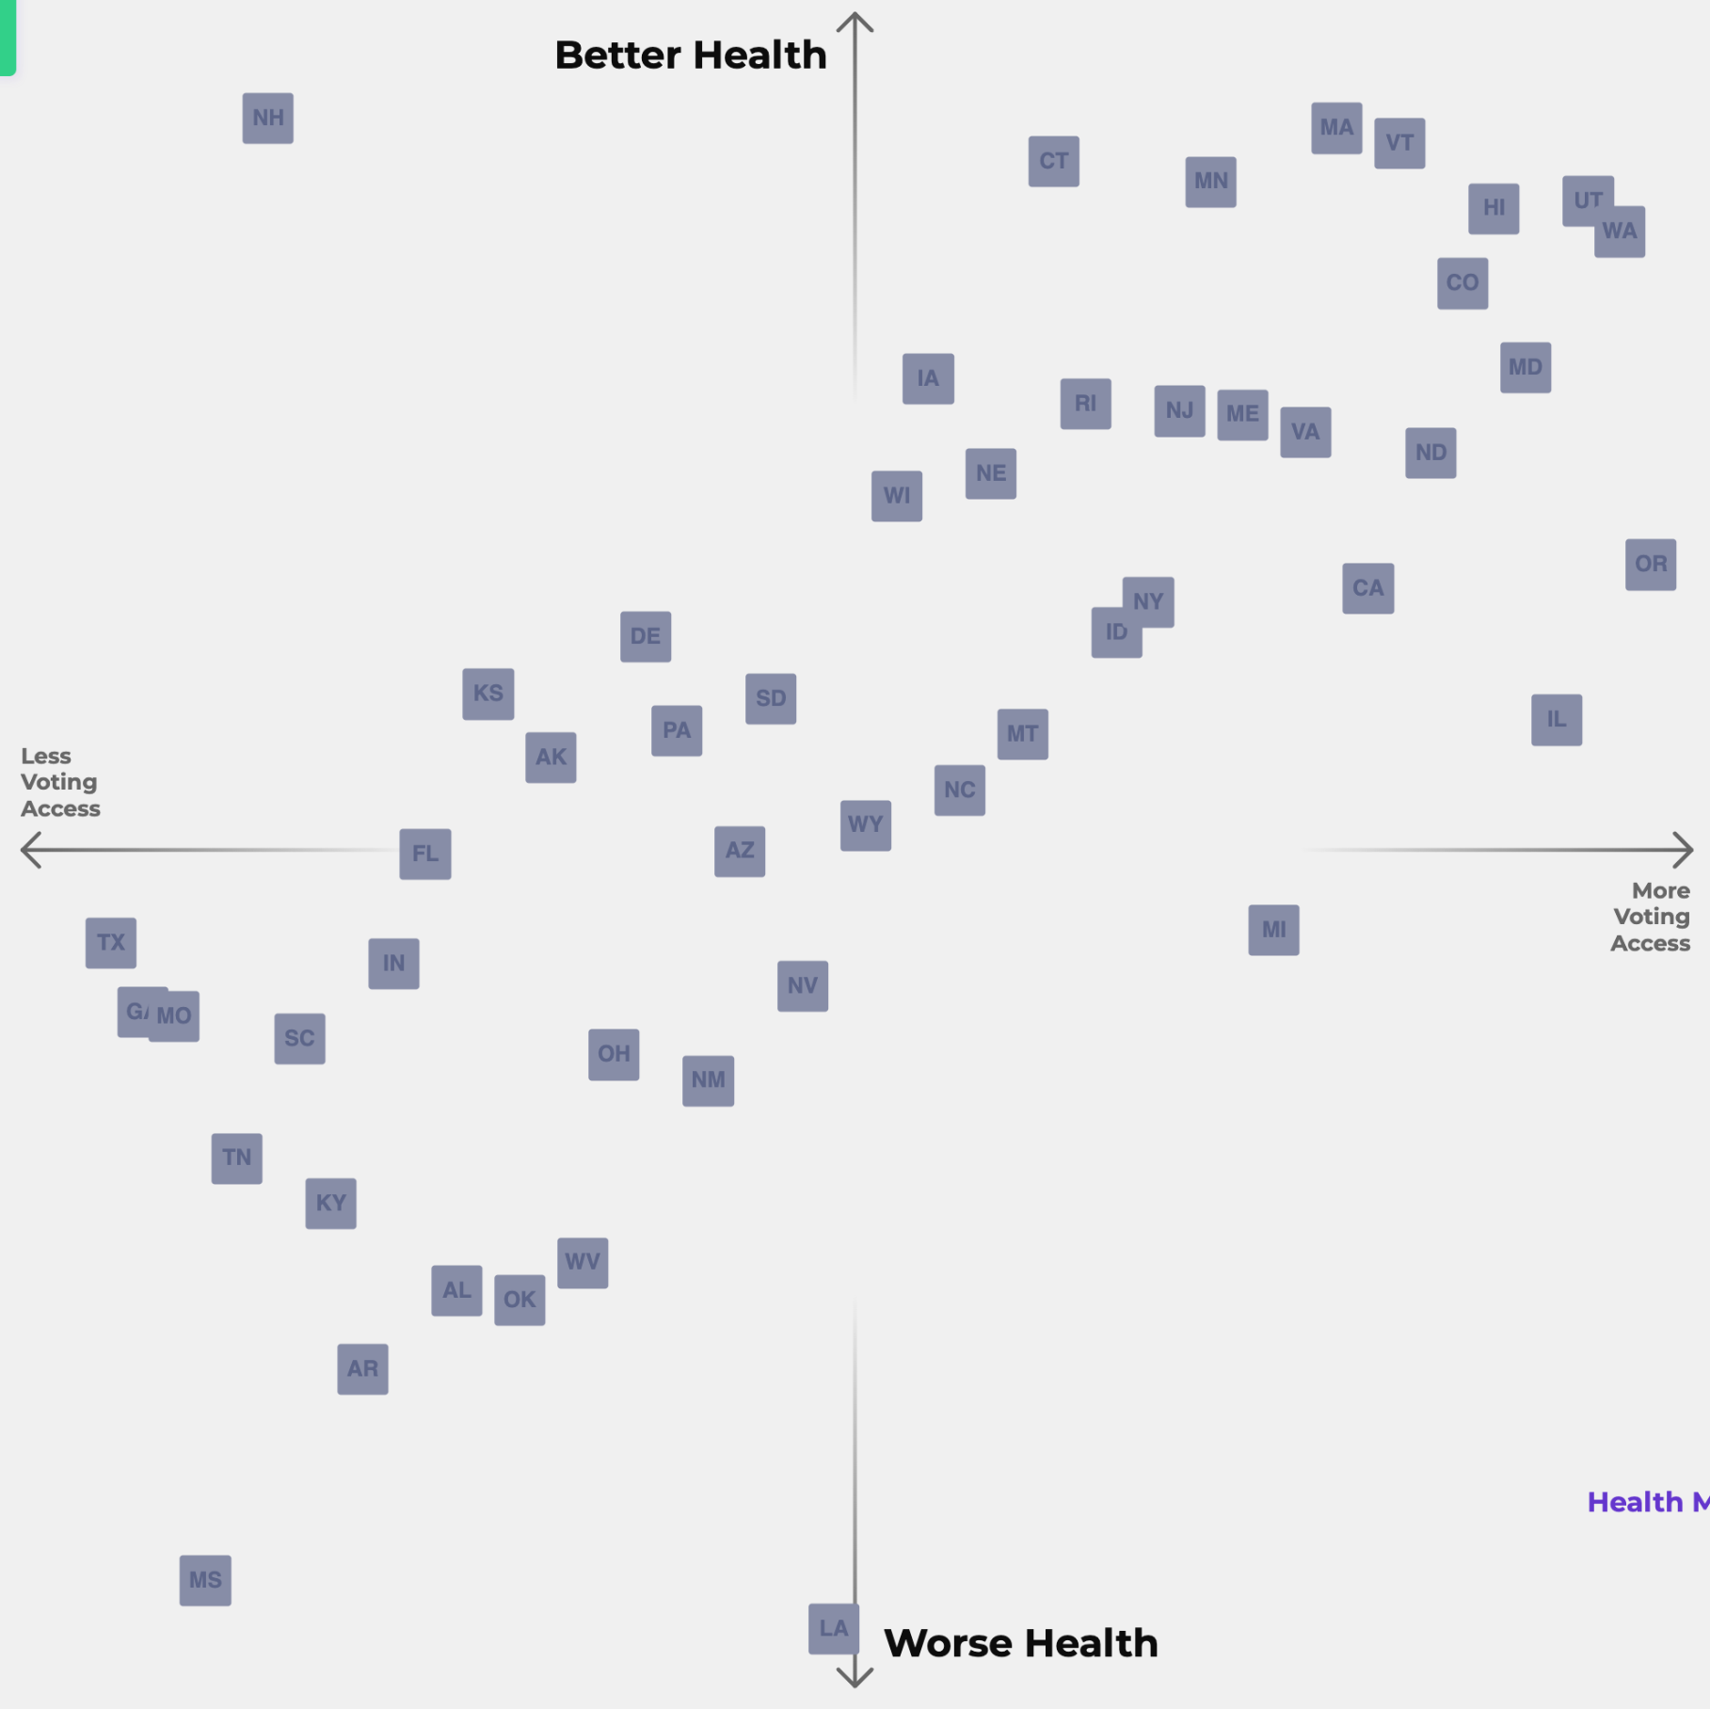

Health & Democracy
| 8

Slide 9
RECENT PEER REVIEWED RESEARCH
States where it is easier to vote are more likely to have:
  better rates of state-level self-reported health across time (1996-2020); Schraufnagle, 2023
  lower uninsured rates; Pabayo et al., 2021
  counties had lower pre-vaccine COVID case and mortality rates; Pabayo et al., 2022
  Lower working age mortality rates; Montez et.al., 2023
Civic engagement (voting, volunteering, and activism) among adolescents and young adults is positively associated with better future income, education levels and mental health compared to non-voters; Ballard et al., 2019
Health & Democracy
| 9

Slide 10










WE HAVE POWER
Largest workforce and accounts for at least 22 million workers which represents about 14% of all workers in the United States.
Health Professionals are trusted messengers in their communities and with policymakers
Health organizations represent thousands of members and institutions working to advance health
Health & Democracy
| 10

Slide 11

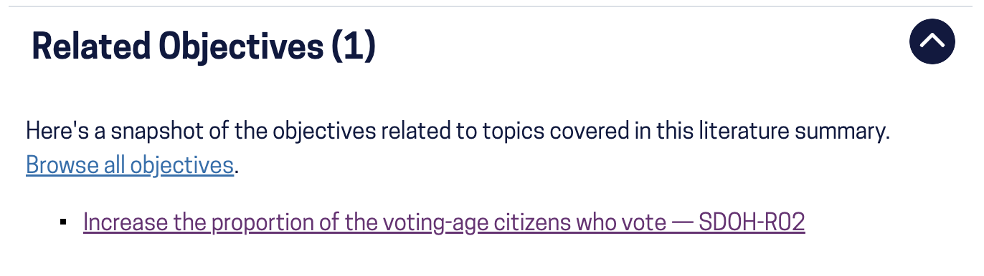

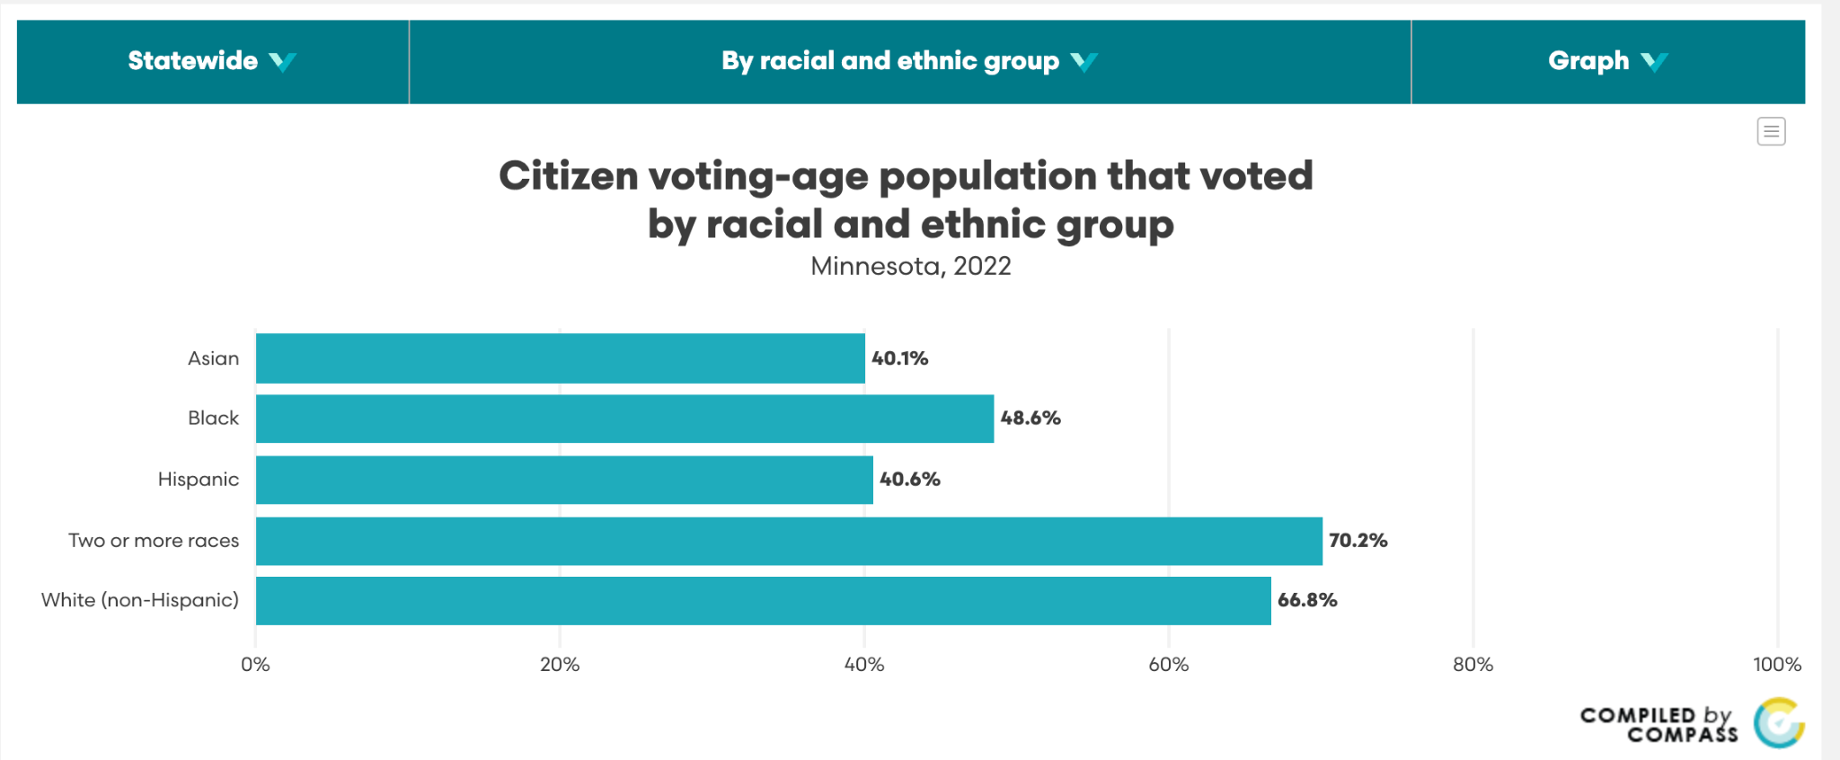
SYSTEMS CHANGE AT EVERY LEVEL
Organization level: adopt policies to change the narrative and context for advocacy– Ex. SOPHE, AMA, APHA
State and local level: join efforts to promote state and local policies expanding voting access and incorporating measures of civic participation into health goal setting (ex MN, MI)
National level: to promote voter registration and participation using administrative levers- HealthCare.gov, Healthy People 2030, County Health Rankings and Roadmaps.
Health & Democracy
| 11

Slide 12
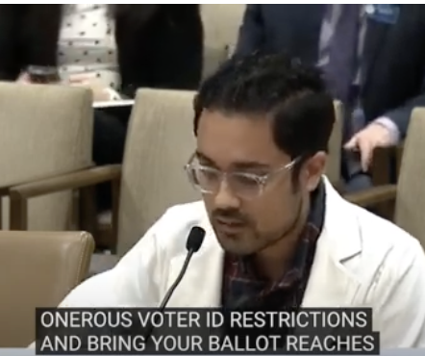
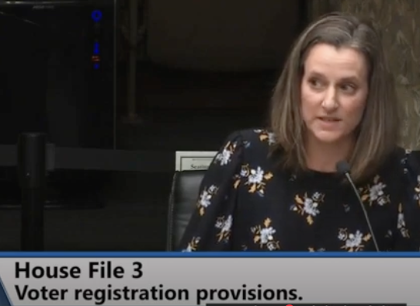
LEVERAGE HEALTH VOICES FOR CHANGE
Health Professionals are trusted messengers in our communities. We can effectively support positive policy efforts by communicating about the impacts that policy has on the communities we serve, especially with an eye on senior citizens, veterans, and people with disabilities, as well as us: health professionals
Health & Democracy
| 12

Slide 13

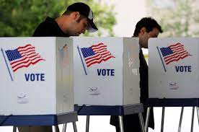
HEALTH IS ALWAYS ON THE BALLOT– WHAT CAN YOU DO?
Make a voting plan for every election (especially local ones)
Invite colleagues, friends, and family to make voting plan
Promote opportunities for civic and voter participation in your workplace
Invite your colleagues to learn more!
Health & Democracy
| 13

Slide 14
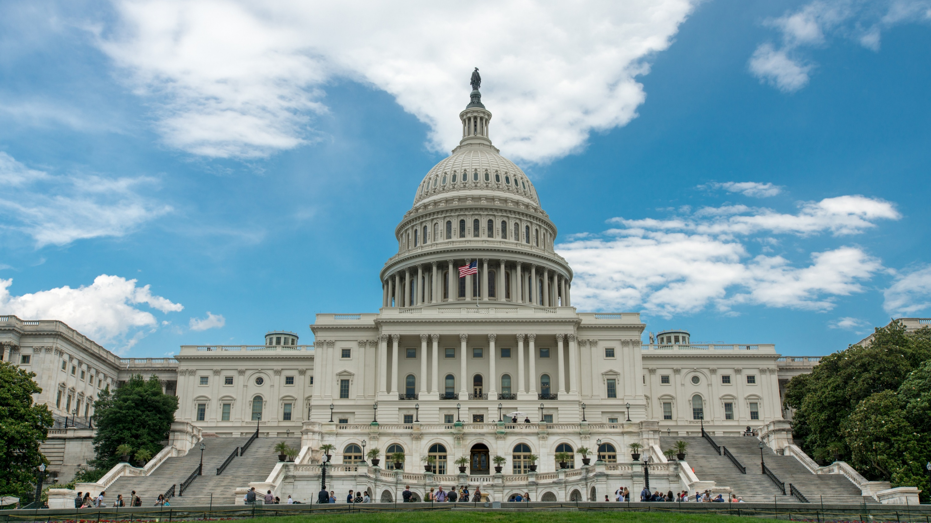

ASPPH Presents - Webinar
Voting is Public Health:
Polling, Civic Engagement and the Road to the Midterms
Amy Souders, Principal and Director
Cornerstone Government Affairs
September 28, 2026

Slide 15


2026 Midterms Overview
The Republican party aims to maintain its trifecta while Democrats seek to claim a majority. Midterm elections historically favor the opposition party, but Democrats will need to gain seats in historically Republican areas. The political environment currently favors Democratic gains, although Republicans retain advantages in both the House and Senate maps.
THE MAJORITY
Republicans currently hold a 53-47 majority in the Senate; 22 of the 35 Senate seats up for election are Republican-held, giving Democrats an opportunity to flip the chamber
Republicans hold a slim 218-214 majority in the House, with one independent and two seats currently vacant; The Cook Political Report rates 21 seats as toss-up, giving Democrats an opportunity to flip the chamber
SENATE
HOUSE OF REPRESENTATIVES
36 states will hold gubernatorial elections in 2026, with 5 seats rated toss-ups by the Cook Political Report
88 of the 99 state legislative chambers in the US will hold elections in 2026, with Republicans currently controlling 55% of seats nationally
GOVERNOR
STATE LEGISLATURE
SOURCE BALLOTPEDIA, COOK POLITICAL REPORT WITH AMY WALTER, HOUSE PRESS GALLERY, CONGRESS.GOV

Slide 16
Potential 2026 Election Outcomes
POTUS | SENATE | HOUSE | LIKELIHOOD | LIKELIHOOD ANALYSIS
R | R | D | High ••••• | The president’s party has lost ground in midterm elections in each of the last three midterms, and Democrats would need to flip just five seats to secure a majority in the House
R | D | D | Medium ••••• | Democrats have recruited their ideal Senate candidate in several swing states, including Sherrod Brown in Ohio and Mary Peltola in Alaska, and have strong funding numbers in Texas
R | R | R | Low ••••• | The Senate map is favorable for Republicans, and redistricting efforts across several Republican-led states could help the GOP maintain control if President Trump remains popular with his base
R | D | R | Very Low ••••• | It is highly unlikely that Democrats will perform well enough in states such as Texas, Ohio, or Iowa to flip the Senate, and not secure a House majority as well
SOURCE National Journal

Slide 17
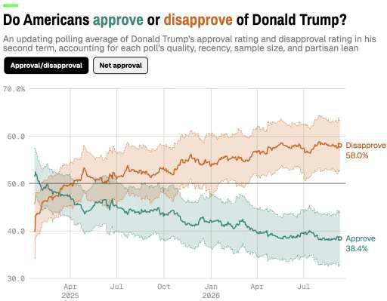
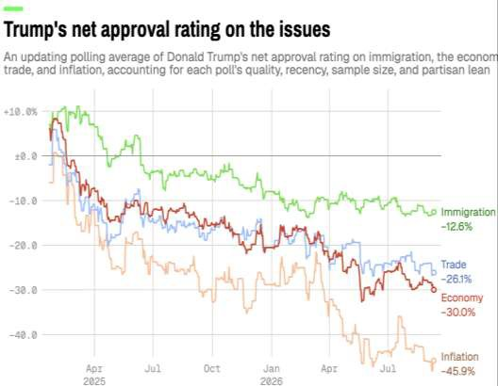
President Donald Trump’s approval rating is historically low; remains underwater on every major issue
Notes:
Updates 9/15

Slide 18
2026 United States Senate balance of power
Republicans currently hold a 53 to 47 seat majority over the Democrats.
SEATS AT STAKE
On November 3, 2026, 33 of the 100 US Senate seats will be contested in regular elections for Class II senators, who were last elected in 2020
UNCONTESTED
UNCONTESTED
Two special elections will also take place: one in Ohio to fill the
remainder of JD Vance’s term after his election to the vice presidency, and another in Florida to replace Marco Rubio, who resigned upon becoming Secretary of State
Republicans are defending 23 of the 35 seats up for election in 2026.
Notes:
“Senators.” US Senate: Senators, February 24, 2025. https://www.senate.gov/senators/.
Skelley, Geoffrey. “Why Republicans Start out as Favorites in the 2026 Senate Elections.” ABC News, December 2, 2024. https://abcnews.go.com/538/republicans-start-favorites-2026-senate-elections/story?id=116243572.
“The 2026 Senate Map Starts to Come into Focus: From the Politics Desk.” NBCNews.com, April 14, 2025. https://www.nbcnews.com/politics/politics-news/2026-senate-map-starts-come-focus-politics-desk-rcna201194.
“United States Senate Elections, 2026.” Ballotpedia. Accessed July 23, 2025. https://ballotpedia.org/United_States_Senate_elections,_2026.

Slide 19
Seven Senate seats are considered toss-ups in the
2026 election
WA
Cook Political Report:
2026 Senate ratings
MT
ND
VT
ME
OR
MN
ID
SD
WI
NY
NH
■ Solid D
■ Likely D
■ Lean D
■ Toss Up
■ Lean R
■ Likely R
■ Solid R
■ No election
WY
MI
NE
IA
PA
MA
NV
UT
OH
IL
IN
RI
CA
CO
WV
VA
KS
MO
KY
CT
TN
NC
NJ
AZ
NM
OK
AR
SC
DE
MS
AL
GA
MD
AK
TX
LA
HI
FL
Notes:
Updated 9/23

Slide 20
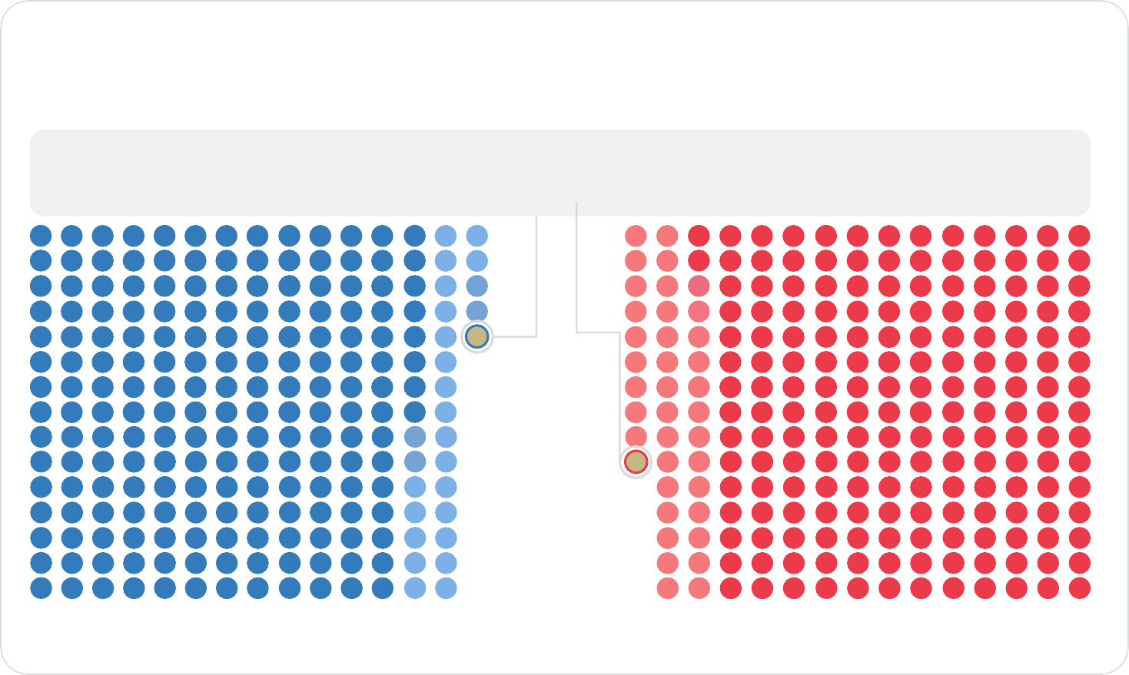



2026 United States House balance of power
Pending the outcome of potential special elections ahead of November’s general election, the Republican-aligned majority is expected to enter the midterms with a 218* to 214 advantage, meaning Democrats would need a net gain of three seats to take control of the House
S TAT E O F P L AY
There are currently two vacancies in the U.S. House: Florida’s 20th Congressional District (Cook PVI D+20) and
Texas’s 23rd Congressional District (R+7). No special elections have been scheduled.
On November 3, 2026, voters will elect representatives in all 435 congressional districts across the 50 US states, with 218 seats required for either party to win control of the chamber
60 representatives, 23 Democrats and 37
Republicans, are not running for re-election
Ten states have redrawn their congressional maps, either to gain a partisan advantage in their congressional delegation or in response to court challenges to existing maps
Democratic incumbent retiring Republican incumbent retiring ■
*Rep. Kevin Kiley (currently CA-03) is an independent who caucuses with Republicans and is running in the newly drawn CA-06 in 2026
SOURCE BALLOTPEDIA, AXIOS, ABC, NBC, AP
Notes:
Updated 9/15

Slide 21
Twenty-one House districts are considered toss-ups in the
2026 election
Cook Political Report: 2026 House ratings
■ Solid D
■ Likely D
■ Lean D
■ Toss Up
■ Lean R
■ Likely R
■ Solid R
Notes:
Updated 9/22
‌

Slide 22
Cook Political Report Race Ratings of 2026 governor seats
SOLID D 13 DEM ⦁ 0 GOP | LIKELY D 0 DEM ⦁ 0 GOP | LEAN D 3 DEM ⦁ 1 GOP | TOSS UP 1 DEM ⦁ 4 GOP | LEAN R 1 DEM ⦁ 0 GOP | LIKELY R 0 DEM ⦁ 3 GOP | SOLID R 0 DEM ⦁ 10 GOP
Newsom (CA) Polis (CO) Lamont (CT) Green (HI) Pritzker (IL) Healey (MA) Moore (MD) Mills (ME) Walz (MN) Lujan Grisham (NM) Hochul (NY) Shapiro (PA) McKee (RI) |  | Hobbs (AZ) Whitmer (MI) Kotek (OR) Reynolds (IA) | Dunleavy (AK) Kemp (GA) Lombardo (NV) DeWine (OH) Evers (WI) | Kelly (KS) | Ayotte (NH) DeSantis (FL) Abbott (TX) | Ivey (AL) Sanders (AR) Little (ID) Pillen (NE) Stitt (OK) McMaster (SC) Rhoden (SD) Lee (TN) Scott (VT) Gordon (WY)
Democratic-held seat
Republican-held seat
Incumbent not seeking reelection
SOURCE Cook Political Report with Amy Walter
Notes:
Updated 9/21

Slide 23
Five gubernatorial seats are considered toss-ups in the 2026 elections
Cook Political Report: 2026 Governor ratings
WA
Cook Political Report: 2026 Governor ratings
MT
ND
VT
ME
OR
MN
ID
SD
WI
NY
NH
WY
MI
NE
IA
PA
MA
■ Solid D
■ Likely D
■ Lean D
■ Toss Up
■ Lean R
■ Likely R
■ Solid R
■ No election
NV
UT
OH
IL
IN
RI
CA
CO
WV
VA
KS
MO
KY
CT
TN
NC
NJ
AZ
NM
OK
AR
SC
DE
MS
AL
GA
MD
AK
TX
LA
HI
FL
SOURCE THE COOK POLITICAL REPORT WITH AMY WALTER
Notes:
Updated 9/23

Slide 24
Relevant Committees

Slide 25
Senate Appropriations Committee
LHHS Subcommittee
Republicans:
Shelley Moore Capito (WV) Chair – Up for reelection
Jerry Moran (KS)
John Kennedy (LA)
Cindy Hyde-Smith (MS) – Up for reelection
John Boozman (AR)
Katie Britt (AL)
Mike Rounds (SD) – Up for reelection
Jon Husted (OH) – Up for reelection
Darline Graham (SC) – Up for reelection
Democrats:
Tammy Baldwin (WI) Ranking Member
Patty Murray (WA)
Dick Durbin (IL) – Retiring
Jack Reed (RI) – Up for reelection
Jeanne Shaheen (NH) – Retiring
Jeff Merkley (OR) – Up for reelection
Brian Schatz (HI)
Chris Murphy (CT)

Slide 26
House Appropriations Committee
LHHS Subcommittee
Republicans:
Robert Aderholt (AL) Chair
Mike Simpson (ID)
Andy Harris (MD)
Chuck Fleischmann (TN)
John Moolenaar (MI)
Julia Letlow (LA) – Running for Senate
Andrew Clyde (GA)
Jake Ellzey (TX)
Stephanie Bice (OK)
Riley Moore (WV)
Democrats:
Rosa DeLauro (CT) Ranking Member
Steny Hoyer (MD) – Retiring
Mark Pocan (WI)
Lois Frankel (FL)
Bonnie Watson Coleman (NJ) – Retiring
Josh Harder (CA)
Madeleine Dean (PA)

Slide 27
Senate Health, Education, Labor, and Pensions (HELP) Committee
Republicans:
Bill Cassidy (LA) Chair – Lost reelection
Rand Paul (KY)
Susan Collins (ME) – Up for reelection
Lisa Murkowski (AK)
Roger Marshall (KS) – Up for reelection
Tim Scott (SC)
Josh Hawley (MO)
Tommy Tuberville (AL) – Running for governor
Jim Banks (IN)
Jon Husted (OH) – Up for reelection
Ashley Moody (FL) – Up for reelection
Alan Armstrong (OK) – Retiring
Democrats:
Bernie Sanders (VT) Ranking Member
Patty Murray (WA)
Tammy Baldwin (WI)
Chris Murphy (CT)
Tim Kaine (VA)
Maggie Hassan (NH)
John Hickenlooper (CO) – Up for reelection
Ed Markey (MA) – Up for reelection
Andy Kim (NJ)
Lisa Blunt Rochester (DE)
Angela Alsobrooks (MD)
Notes:
Sen. Roger Marshall may take over leadership for the Republicans. He has gone around Sen. Bill Cassidy in the past to work with Sen. Bernie Senders.

Slide 28
House Energy and Commerce Committee
Health Subcommittee
Democrats:
Diana DeGette (CO) Ranking Member – Lost primary
Frank Pallone (NJ) Full Committee Ranking Member
Raul Ruiz (CA)
Debbie Dingell (MI)
Robin Kelly (IL) – Lost bid for Senate
Nanette Diaz Barragán (CA)
Kim Schrier (WA)
Lori Trahan (MA)
Marc Veasey (TX) – Retiring
Lizzie Fletcher (TX)
Alexandria Ocasio-Cortez (NY)
Jake Auchincloss (MA)
Troy Carter (LA)
Greg Landsman (OH)
Republicans:
Morgan Griffith (VA) Chair
Brett Guthrie (KY) Full Committee Chair
Diana Harshbarger (TN)
Gus Bilirakis (FL)
Buddy Carter (GA) – Lost bid for Senate
Neal Dunn (FL) – Retiring
Dan Crenshaw (TX) – Lost primary
John Joyce (PA)
Troy Balderson (OH)
Mariannette Miller-Meeks (IA)
Kat Cammack (FL)
Jay Obernolte (CA)
Cliff Bentz (OR)
Erin Houchin (IN)
Nick Langworthy (NY)
Tom Kean (NJ)
Michael Rulli (OH)
Notes:
Rep. Kathy Castor, current Democratic leader on the E&C Energy Subcommittee, may make a play to lead the Health Subcommittee. She is in a competitive reelection race.

Slide 29
Questions?

Slide 30

More Than a Vote: Building a Culture of Civic Engagement
Beeta Rasouli, MPH

Slide 31

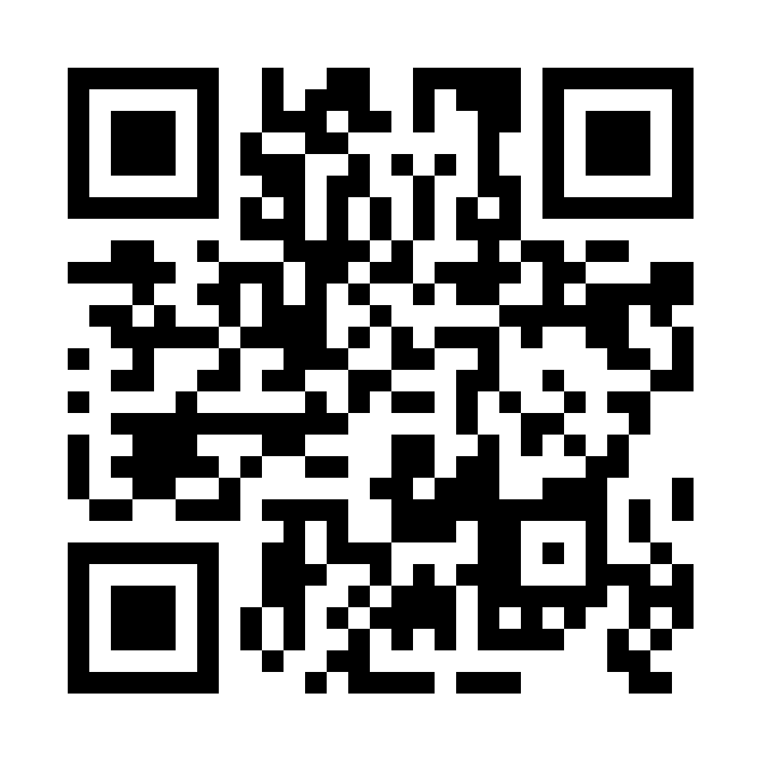
Voting Is Public Health
Notes:
Civic participation helps shape the policies that affect public health
Voting provides communities with a voice in decisions that affect their health
Promoting civic engagement is consistent with public health’s commitment to healthier communities

Slide 32
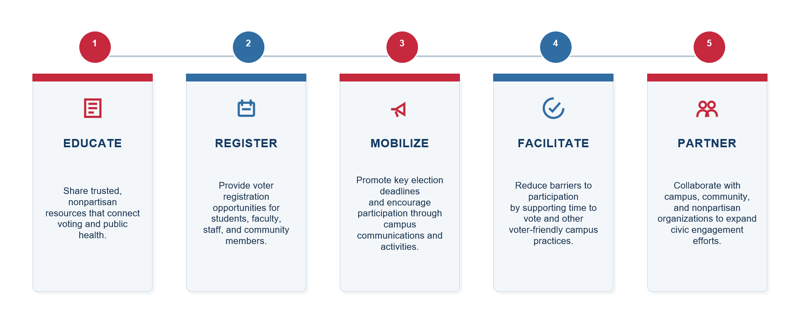
The Role of Academic Public Health

Slide 33
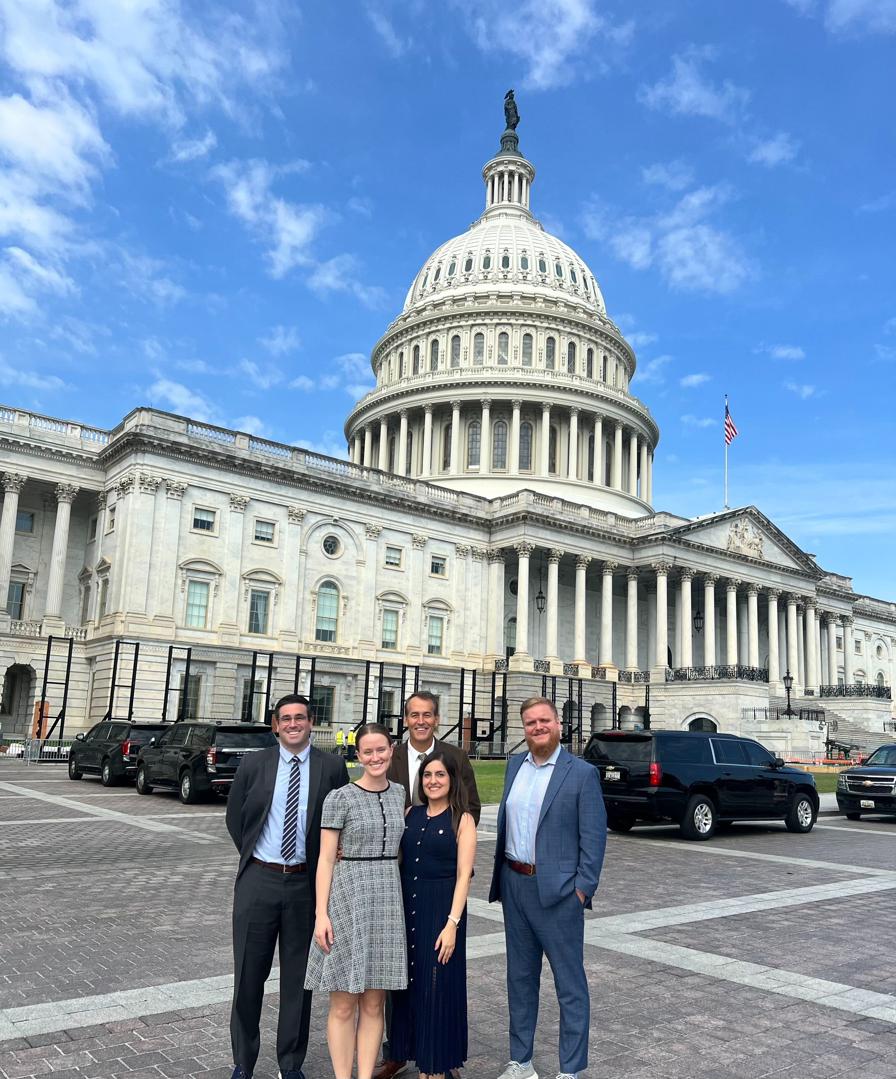
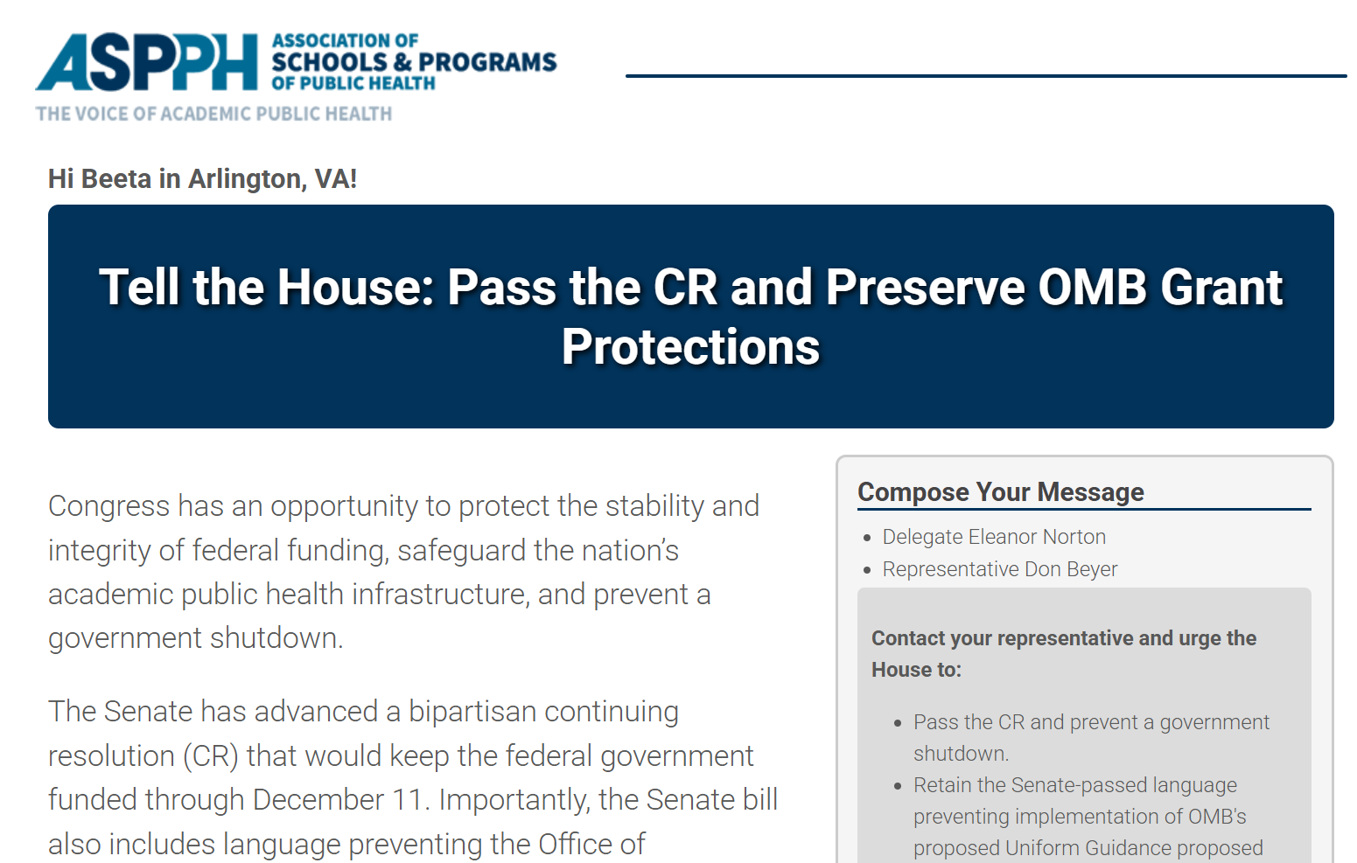
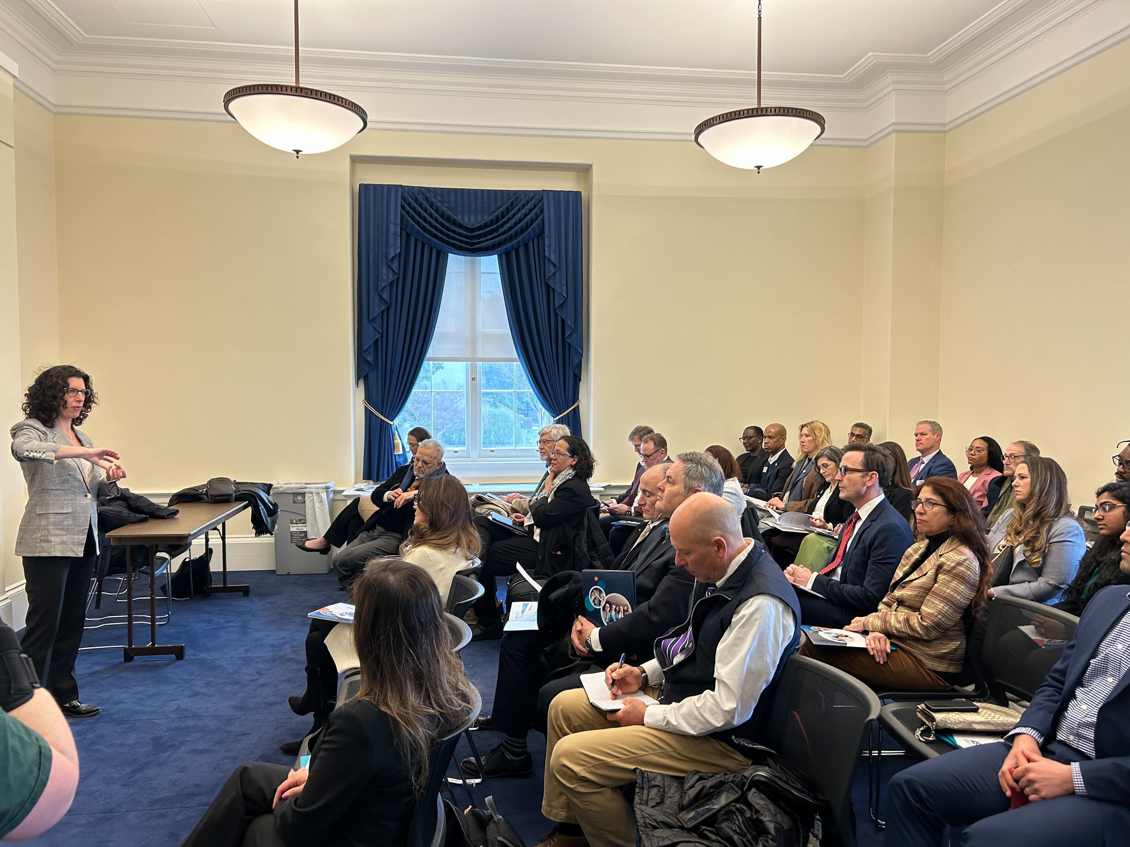
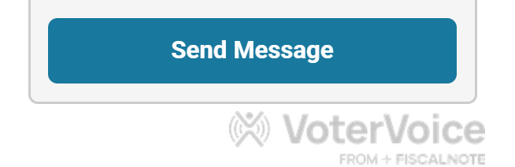
Civic Engagement Beyond the Ballot
Voting is one important form of civic participation
Civic engagement also means making public health expertise heard in the policymaking process
ASPPH Hill Days, Congressional Calls to Action, Member Advocacy Opportunities

Slide 34
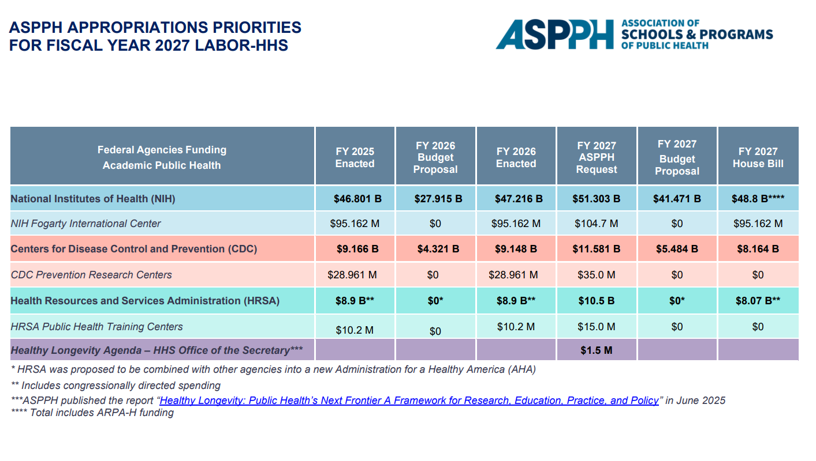
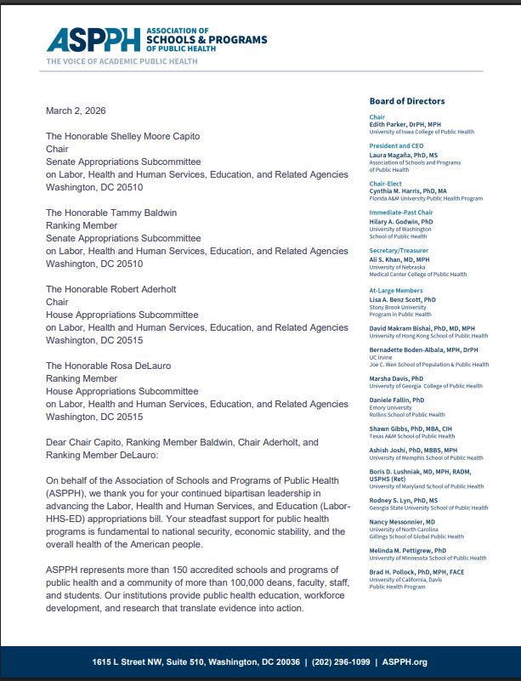




ASPPH Policy Priorities and Resources
https://aspph.org/what-we-do/advocacy/

Slide 35

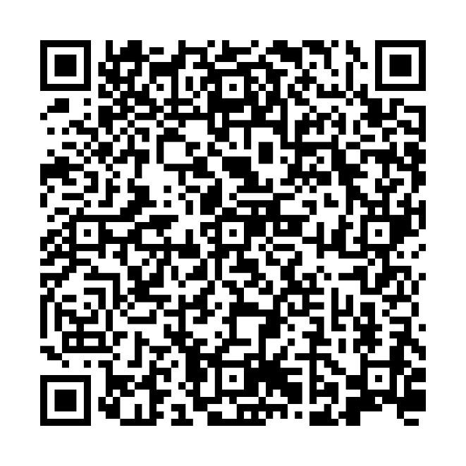

Sign Up for ASPPH Policy Updates!

Slide 36

THANK YOU!
Beeta Rasouli (brasouli@aspph.org)

Slide 37


You can ask questions in writing anytime during the webinar.
Simply click on the Q&A button on the bottom of your screen and type them into the pop-up box.

Slide 38


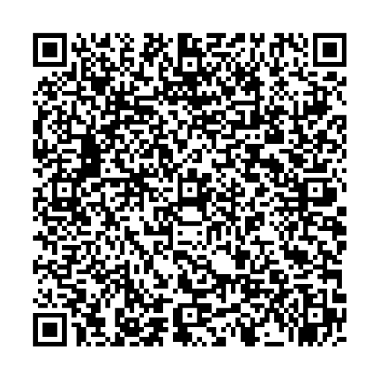
This webinar has been recorded and will be available on the webinar event page on the ASPPH website soon.
Contact: externalrelations@aspph.org

Slide 39

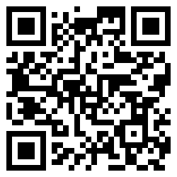
UPCOMING
AI in Action: Practical Applications for Academic Public Health
October 29, 2026, 1:00 – 2:00 PM ET

Slide 40
THANK YOU!

